Slide 1
NAME-INDRASISH KUNDU
CSE 3RD YEAR ROLL-16800117048
COMPUTER NETWORKING ASSIGNMENT

Slide 2

Virtual Circuit Network

Slide 3
Virtual-Circuit Network in Data Communication
A virtual-circuit network is a cross between a circuit-switched network and a datagram network. It has some characteristics of both.
1. As in a circuit-switched network, there are setup and teardown phases in addition to the data transfer phase.
2. Resources can be allocated during the setup phase, as in a circuit-switched network, or on demand, as in a datagram network.
3. As in a datagram network, data are packetized and each packet carries an address in the header. However, the address in the header has local jurisdiction (it defines what should be the next switch and the channel on which the packet is being carried), not end-to-end jurisdiction. The reader may ask how the intermediate switches know where to send the packet if there is no final destination address carried by a packet.
4. As in a circuit-switched network, all packets follow the same path established during the connection.
5. A virtual-circuit network is normally implemented in the data link layer, while a circuit-switched network is implemented in the physical layer and a datagram network in the network layer. But this may change in the future.
The following figure is an example of a virtual-circuit network. The network has switches that allow traffic from sources to destinations. A source or destination can be a computer, packet switch, bridge, or any other device that connects other networks.

Slide 4
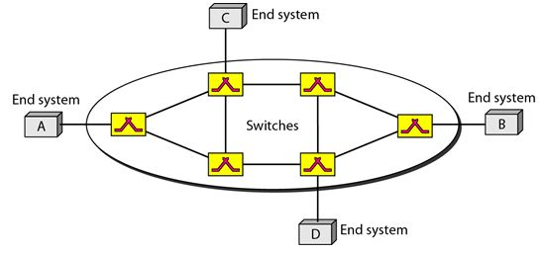
Addressing:

Slide 5
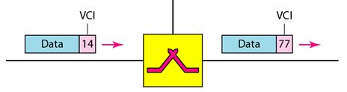
Addressing:
In a virtual-circuit network, two types of addressing are involved: global and local (virtual-circuit identifier). Global Addressing:
A source or a destination needs to have a global address-an address that can be unique in the scope of the network or internationally if the network is part of an international network.
Virtual-Circuit Identifier:
The identifier that is actually used for data transfer is called the virtual-circuit identifier (VCI). A VCI, unlike a global address, is a small number that has only switch scope. It is used by a frame between two switches. When a frame arrives at a switch, it has a VCI; when it leaves, it has a different VCI. The following figure show how the VCI in a data frame changes from one switch to another. Note that a VCI does not need to be a large number since each switch can use its own unique set of VCIs.

Slide 6
Three Phases:
As in a circuit-switched network, a source and destination need to go through three phases in a virtual-circuit network: setup, data transfer, and teardown.
setup phase, the source and destination use their global addresses to help switches make table entries for the connection.
In the teardown phase, the source and destination inform the switches to delete the corresponding entry.
Data transfer occurs between these two phases.
Data Transfer Phase
To transfer a frame from a source to its destination, all switches need to have a table entry for this virtual circuit. The table, in its simplest form, has four columns. This means that the switch holds four pieces of information for each virtual circuit that is already set up. We show later how the switches make their table entries, but for the moment we assume that each switch has a table with entries for all active virtual circuits.
The following figure shows a frame arriving at port 1 with a VCI of 14. When the frame arrives, the switch looks in its table to find port 1 and a VCI of 14. When it is found, the switch knows to change the VCI to 22 and send out the frame from port 3.

Slide 7
